Slide 1

Analysis of Twitter Data to Evaluate Women’s Safety and Inclusion in Society

Slide 2
Table of Contents
Introduction
Literature Review
Objectives
Research Methodology
Result Analysis
Conclusion
References

Slide 3

Introduction
Women Inclusion and Safety in Society
The inclusion and safety of women in modern society is a problem that over the years has become increasingly important in all countries, leading to a large number of awareness campaigns and social movements.
Several investigations were held mainly focusing on interpreting the behaviors of people, also according to their geopolitical situations, for preventing and reducing discrimination situations against women.
Women often feel aggressive harassment which includes trolling, stalking and making sexist remarks.

Slide 4
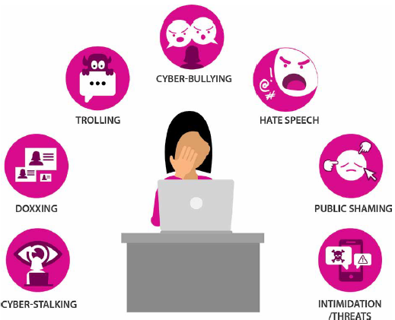
Introduction
Role of Twitter
Twitter is the most popular platform among numerous microblogging platforms that are available on the internet where people share their opinions, ideas, and messages with a limit of 280 characters called “tweets”.
Twitter provides a platform to spread information worldwide. Millions of tweets are posted on Twitter every day from all over the world.
Each tweet expresses an opinion and opinion on the topic. These tweets help to carry out social awareness, product promotion, social issues, and health issues.
Therefore, twitter conversations can be used to analyze the sentiments of people about women’s issues which are very critical issues in our society.

Slide 5
Literature Review
Sr. No. | Author | Techniques / Methodology | Limitations / Comparison
1. | Mamgain et. al [1] | BERT models (SpanBERT, BETO, multilingual BERT) | BERT Models are used to analyze the smaller dataset of Spanish tweets.
2. | B. Gupta et. al [2] | Logistic Regression algorithm was used | Only one classification algorithm was used to find the results attaining 80% accuracy.
3. | Reyes-Menendez et. al [3] | Machine learning algorithm ANN model was used | ANN attained 83% accuracy and dataset is also quite small.
4. | D. Kumar and S. Aggarwal et. al [4] | Supervised Vector Machine (SVM) | Support Vector Machine is used for data classification. Data analyses were done on a smaller dataset.
5. | Sahayak et. al [5] | Python modules such as textblob and Tweepy were used. | No classifier was used to analyze the accuracy of the model.

Slide 6
Problem Statement
To apply data analytics to Twitter data to evaluate women’s safety and inclusion in modern society through statistics and finding correlations and relationships between the most common hashtags, the most frequent occurring keywords and time-location-based sentiment analysis.

Slide 7
Objective
To highlight the rising issue of inclusion and safety of women in modern society by analyzing the opinions, behavior and sentiments of people through tweets.
To investigate the assorted wrongdoings against the ladies by making use of preferred and powerful social media data with the help of specific keywords and hashtags.
To show true insights and educate people about the sensational expansion in the quantity of wrongdoings against women in the form of a web application.

Slide 8
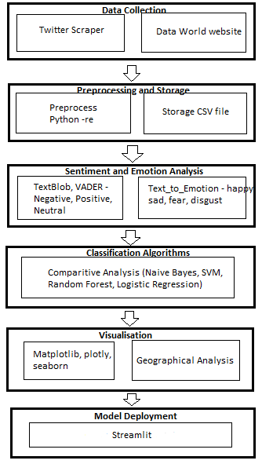
Methodology
Data Collection: Twitter Scraper and the data world website is used for collecting the dataset of tweets.
Preprocessing: Once tweets are collected, tweets are pre-processed to remove unnecessary noise.
Sentiment Analysis: With the help of Text Blob and VADER labeled each tweet as Positive, Negative, and Neutral. Also, emotions will be analyzed using Text_to_Emotion library.
Classifiers: The model goes through different types of classifiers to get the most accurate model, hence, comparative analysis is done between Support Vector Machine (SVM), Random Forest, Naive Bayes and Logistic Regression models.
Visualization: An in-depth visualization will be done with respect to geographical analysis of data.
Model Deployment: The model will be deployed into a web application using Streamlit to make it easier to analyze and visualize.

Slide 9
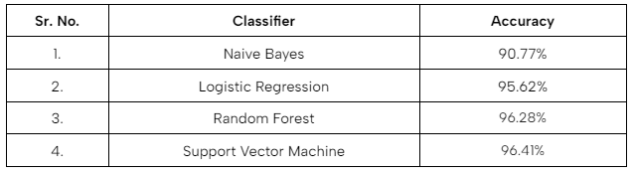
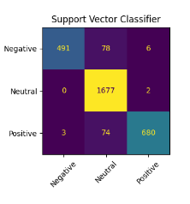
Result Analysis
Comparative Analysis of Different Classifiers
The accuracy of Naive Bayes is 90.77%, Logistic Regression is 95.62%, Random Forest is 96.28% and Support Vector Machine is 96.41%.
Therefore, the best accuracy amongst all is of Support Vector Machine classifier.
Accuracy Table of different classifiers on 15,054 tweets
Confusion Matrix of Support Vector Machine classifier

Slide 10
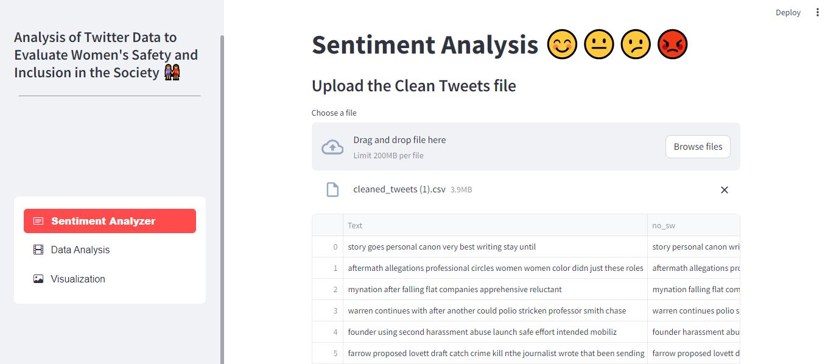
Result Analysis
Home Page

Slide 11
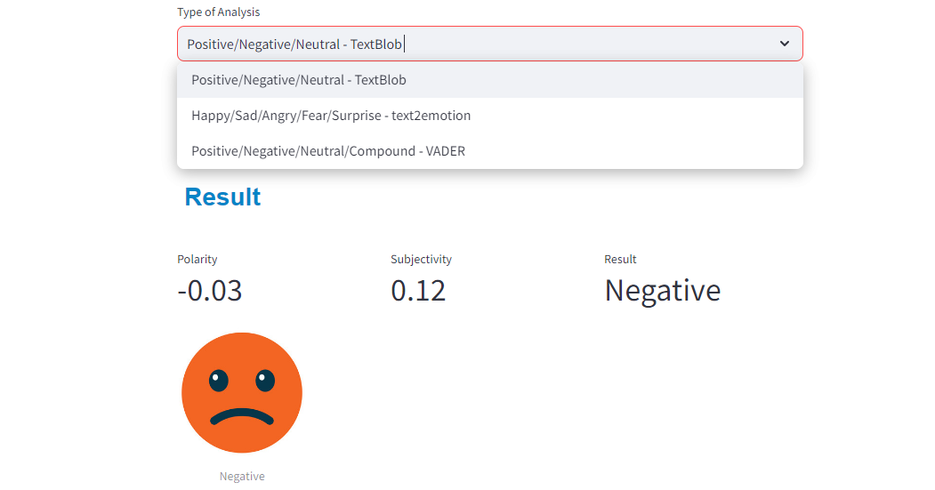
Result Analysis
2. Sentiment Analyzer

Slide 12
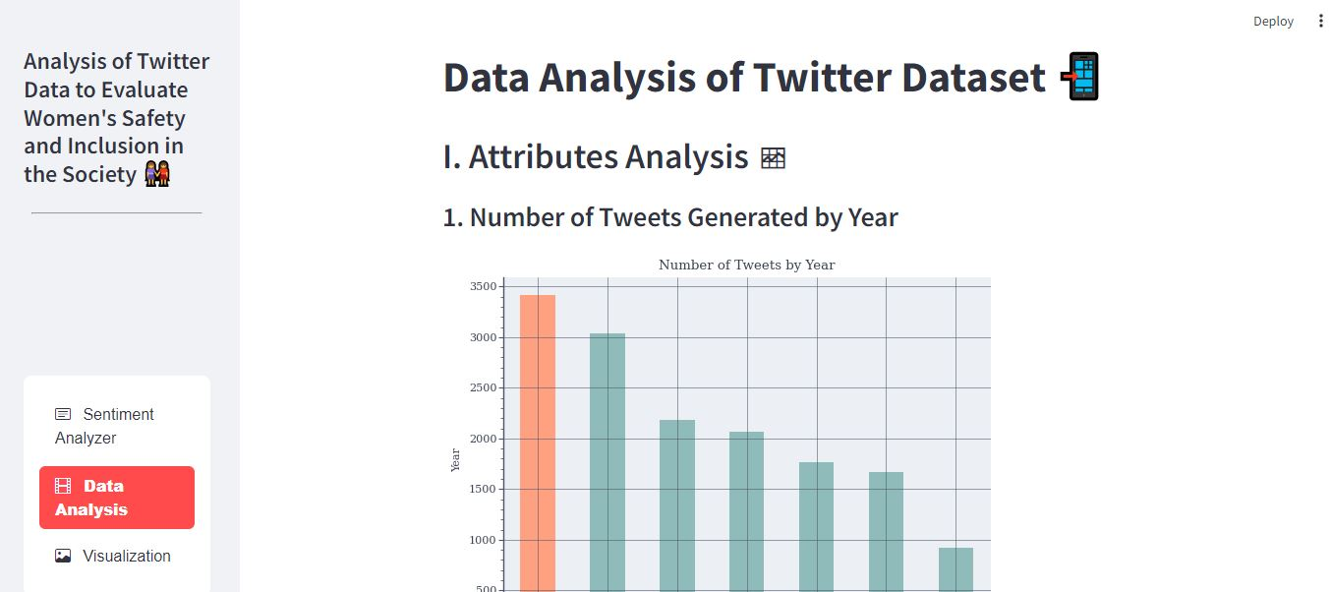
Result Analysis
3. Data Analysis Page

Slide 13
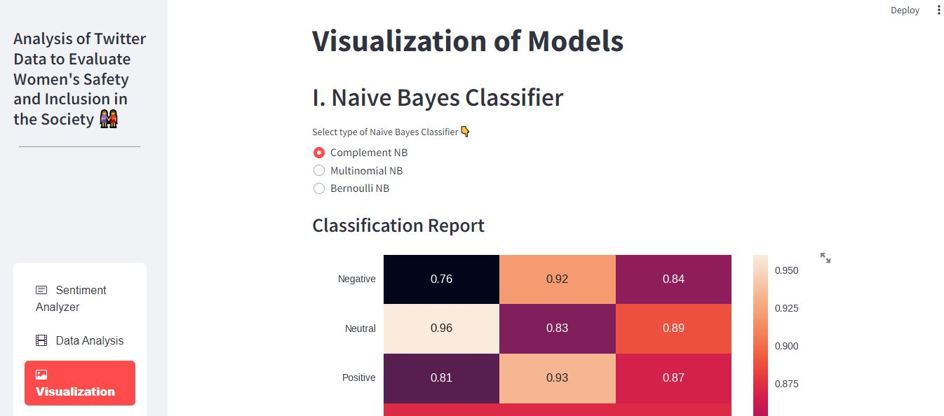
Result Analysis
2. Visualization Page

Slide 14
Conclusion
We gathered a vast amount of tweets about women’s safety and inclusion in the society from the desired dataset and then looked at the most popular hashtags and keywords and the relationships between them.
We employed a sentiment and emotion analysis procedure to highlight the favorable or unfavorable inclination of tweets with special attention to the time of the year and geographcal regions of origin.
We found that a significant number of them are linked to public awareness campaigns and movements such as Me Too that promote women's participation and promptly bring attention to violent situations in accordance with worldwide trends.
We concentrated on the sentiment of tweets and found the reasons behind them which demonstrated a distinct perspective about the social and political landscape in various nations and the importance and power of social media.

Slide 15
References
[1] N. Mamgain, E. Mehta, A. Mittal and G. Bhatt, “Sentiment analysis of top colleges in India using Twitter data”, 2016 International Conference on Computational Techniques in Information and Communication Technologies (ICCTICT), 2016.
[2] B. Gupta, M. Negi, K. Vishwakarma, G. Rawat, and P. Badhani (2017). “Study of Twitter sentiment analysis using machine learning algorithms on Python”. International Journal of Computer Applications, 2017.
[3] A. Reyes-Menendez, J. R. Saura, and C. Alvarez Alons. “Understanding World Environment Day user opinions in Twitter: A topic-based sentiment analysis approach”. International journal of environmental research and public health, 2018 .
[4] D. Kumar and S. Aggarwal. “Analysis of Women Safety in Indian Cities Using Machine Learning on Tweets”, 2019 Amity International Conference on Artificial Intelligence (AICAI), 2019.
[5] V. Sahayak, V. Shete, and A. Pathan (2015). “Sentiment analysis on twitter data. International Journal of Innovative Research in Advanced Engineering (IJIRAE)”(2020).
[6] D Swapna, Jampana Ashrita, Karpe Ashwini, Talasila Bindhu Bhargavi , “Analysis of Women Safety in Indian Cities Using Twitter Data.” Journal Of Composition Theory (2021).
[7] Y Md, Riyazuddin & Sriram, G & Vaibhav, P & Vikranth, I. (2020). Utilization Of Support Vector Machine for Analyzing Women Safety in Indian States. International Journal of Grid and Distributed Computing, 2020.
[8] Raparthi Shravya, Dr.P. Neelakantan, “Women Protection Analysis Based On Twitter Data Using ML” European Journal of Molecular & Clinical Medicine, ISSN 2515-8260, 2020.
[9] B. Durga Bhavani, S. Vaishnavi, T. Akshara, S. Vaishnavi, V. Harini, “Machine Learning Application: The Role of Social Media in Promoting the Safety of Women in Indian Cities”, Journal of Cardiovascular Disease Research, 2023.
[10] Apoorv Agarwal, Boyi Xie, Ilia Vovsha, Owen Rambow, Rebecca Passonneau, “Sentiment Analysis of Twitter Data”, Department of Computer Science, Columbia University, New York, NY 10027 USA, 2022.
[11] Ranjitha, Pradeep Nayak , Vedanth M, Mahantesh G, Namitha D, “Sentiment Classification on Women Safety across Indian Cities Based on Twitter Data using NLP and Machine Learning”, Alvas Institute of Engineering and Technology, Moodbidri, Karnataka, India, 2022.
[12] Pandya, Rahul, and Sujal Charak. “Polarity Testing and Analysis of Tweets in Twitter Using Tweepy.” International Journal of Computational Research, 2021.

